Slide 1
Customer Churn Presentation
Did you know that attracting a new customer costs five times as much as keeping an existing one?

Slide 2
Table of contents
01
02
03
04
05
06
Introduction

Slide 3

01
Introduction

Slide 4
Inroduction
Customers in the telecom industry can choose from a variety of service providers and actively switch from one to the next. The telecommunications business has an annual churn rate of 15-25 percent in this highly competitive market. To reduce customer churn, telecom companies need to predict which customers are at high risk of churn.
To detect early signs of potential churn, one must first develop a holistic view of the customers and their interactions across numerous channels, including store/branch visits, product purchase histories, customer service calls, Web-based transactions, and social media interactions, to mention a few.

Slide 5
FEATURES
Customer Behavior
Account Information
Service Usage Patterns
Usage Frequency: How often the customer uses the service or product.
Product/Service Usage: Specific features or aspects of the product or service used by the Customer.
Session Duration: The average time spent by the customer in each session or visit.
Account Age: How long the customer has been with the company.
Account Type: Type of account or subscription level the customer holds.
Contract Length: Duration of the contract or subscription.
Billing Information: Payment methods, frequency of payments, and any billing issues.
Churn History: Whether the customer has a history of switching services or products.
Service Upgrades/Downgrades: Changes in the service or product level.
Promotional Offers: Response to promotions or special offers.

Slide 6
Scope
Descriptions
Pricing strategy
Provide a detailed description of your products or services, highlighting their features and benefits. Use images or videos to help illustrate your offerings
Discuss your pricing strategy, including any discounts or promotions you offer. Explain how you arrived at your pricing model and why it is competitive
Development
Customer support
Share any plans you have for developing new products or services in the future. Explain how these offerings will address a need in the market and differentiate from others
Describe customer support services offered, including technical support, training, and warranties/guarantees. Highlight customer success stories to demonstrate effectiveness

Slide 7
Scope
Business Impact
Customer Satisfaction
Marketing and sales strategy
Customer Efficiency
Customer Lifeline value
Revenue Protection
Improved customer service
Personalized Retention Strategies
T
Sales process
Analysis
Goals
Describe how you plan to convert leads into customers through your sales process
Analyze the strengths and weaknesses of your competitors in terms of their products/services, pricing strategy…
Define key performance indicators (KPIs) that measure the success of your marketing and sales efforts. Set specific goals

Slide 8
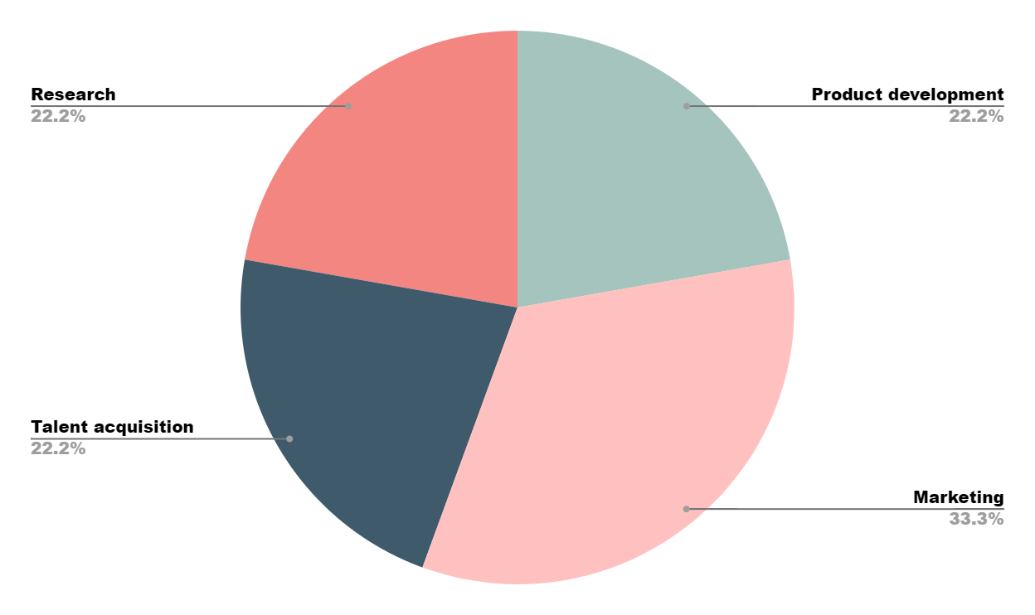
Pie chart
$1,000,000
$1,500,000
$58,300,000
$81,000,000
Product development
Marketing
Talent acquisition
Research
Follow the link in the graph to modify its data and then paste the new one here. For more info, click here

Slide 9
Conclusion

Slide 10
THANK YOU!!

